Slide 1

Data Mining 2020 K-Means Clustering
Catedrático: Franz Haidacher

Slide 2
K-Means Clustering Algorithm
1. Choose the number K of clusters
2. Select random K points as cluster centroids
3. Assign each data point to the closest centroid
4. Compute and place new centroid for each cluster
5. Reassign each data point to the new closest centroid
(if any point was reassigned then goto step 4, else end)

Slide 3
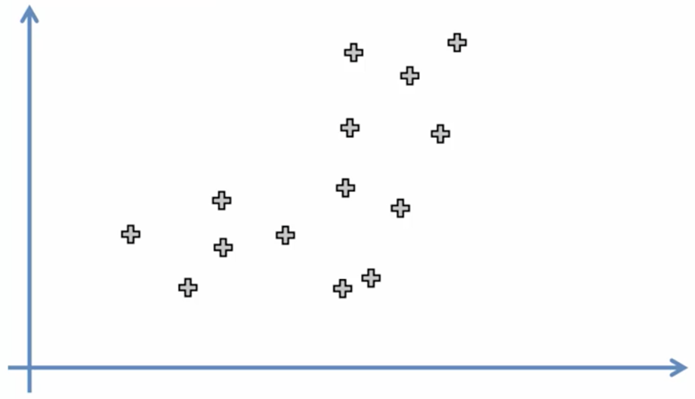
Step 1: Choose the number K of clusters
2

Slide 4
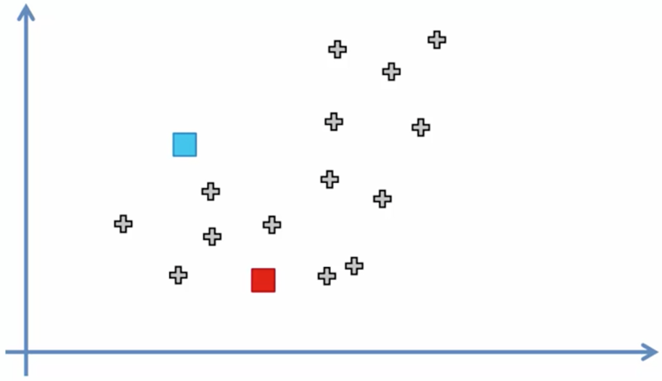
Step 2: Select random K points as cluster centroids

Slide 5
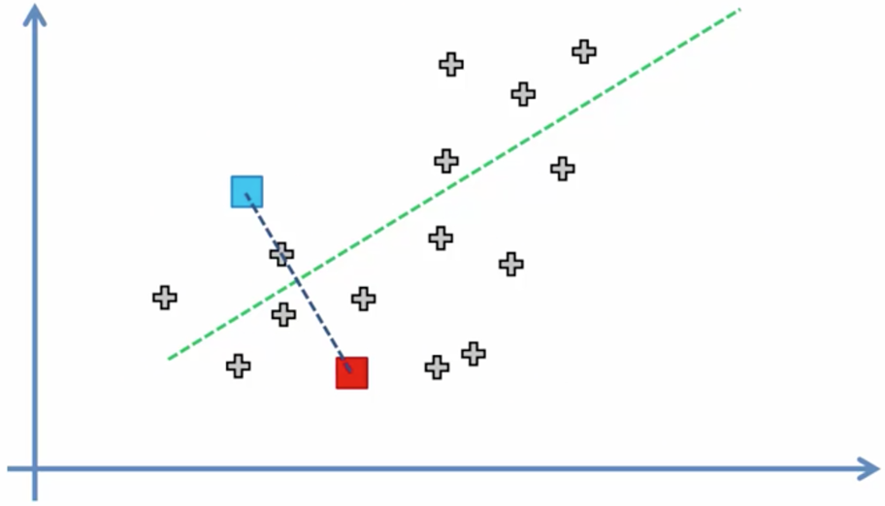
Step 3: Assign each data point to the closest centroid

Slide 6
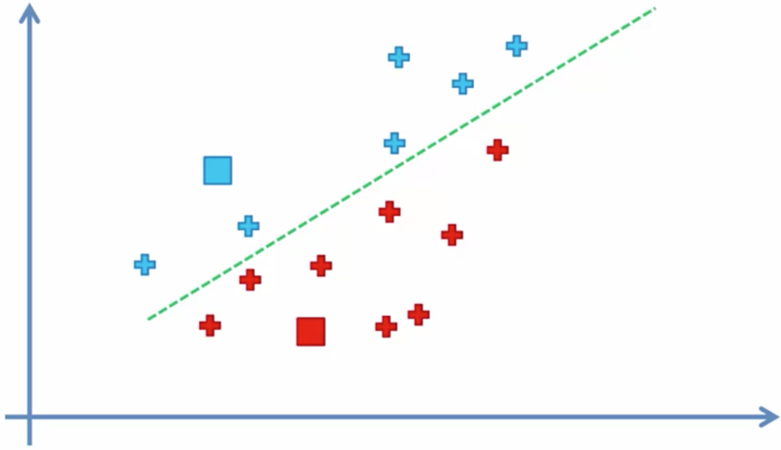
Step 3: Assign each data point to the closest centroid

Slide 7
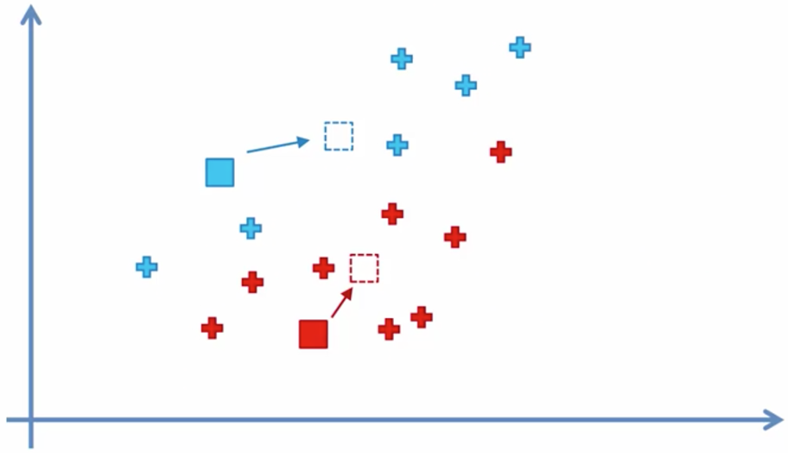
Step 4: Compute and place new centroid for each cluster

Slide 8
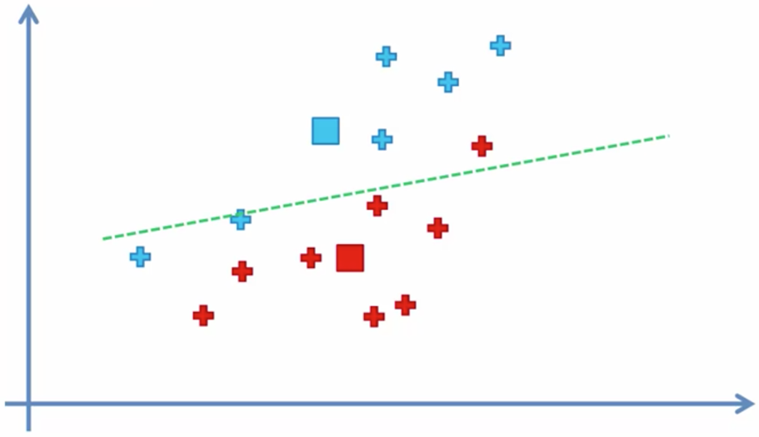
Step 5: Reassign each data point to the new closest centroid

Slide 9
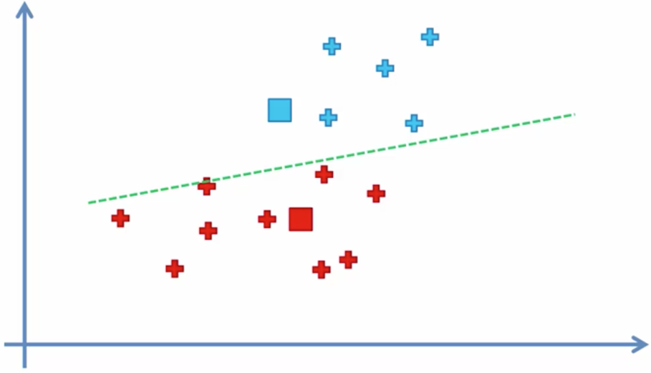
Step 5: Reassign each data point to the new closest centroid

Slide 10
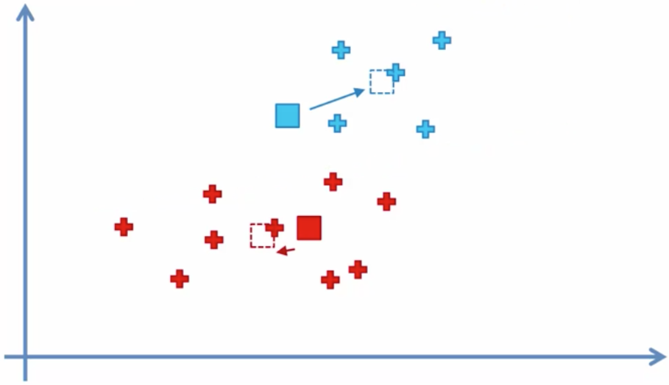
Step 4: Compute and place new centroid for each cluster

Slide 11
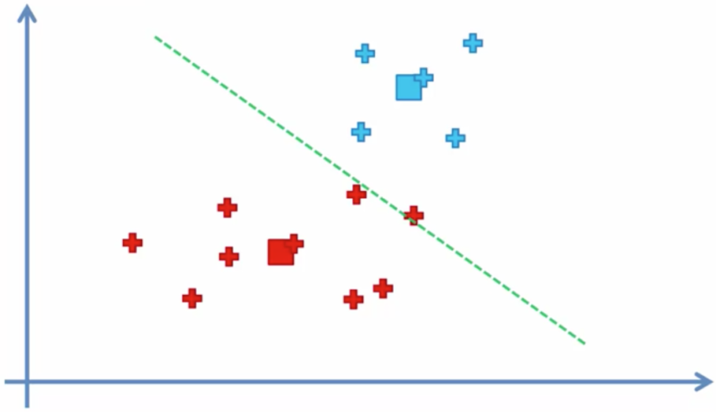
Step 5: Reassign each data point to the new closest centroid

Slide 12
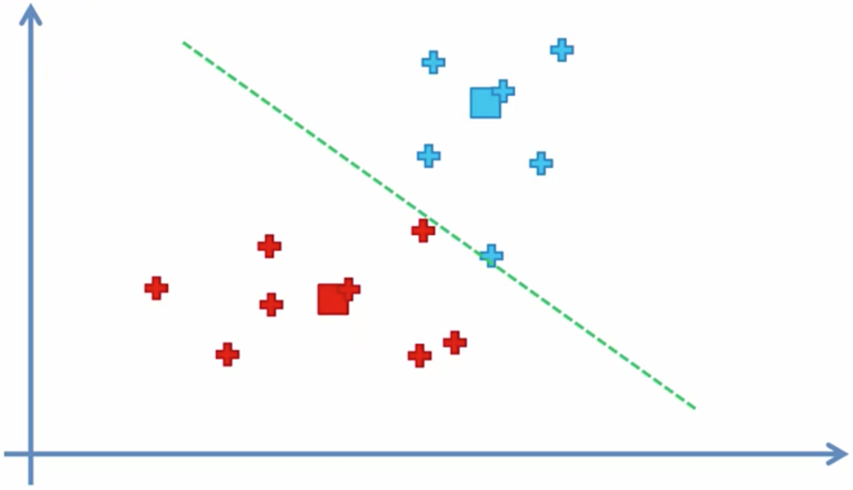
Step 5: Reassign each data point to the new closest centroid

Slide 13
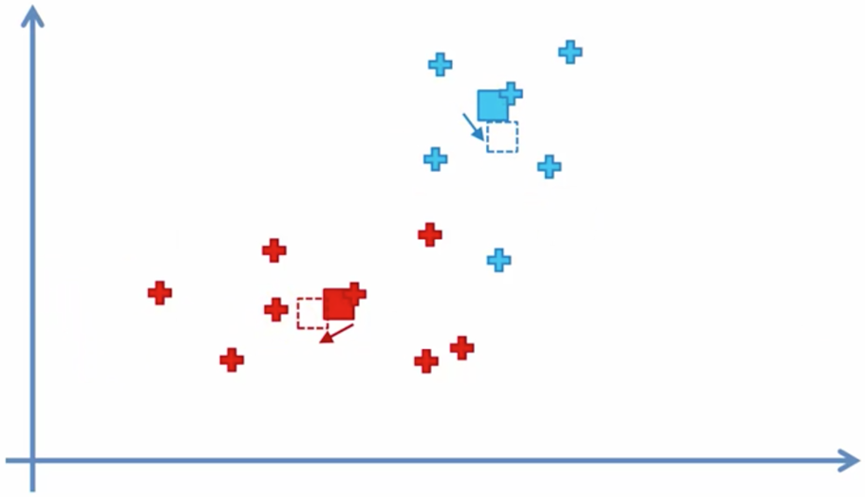
Step 4: Compute and place new centroid for each cluster

Slide 14
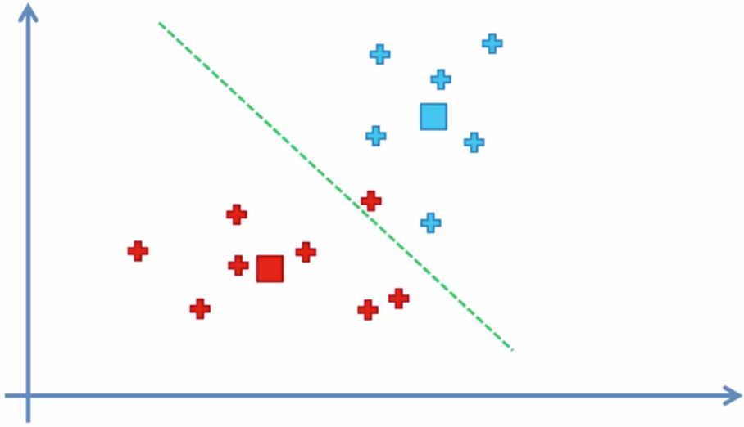
Step 5: Reassign each data point to the new closest centroid

Slide 15
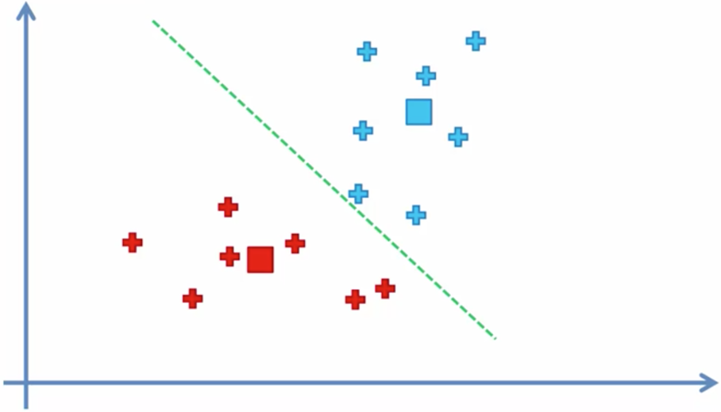
Step 5: Reassign each data point to the new closest centroid

Slide 16
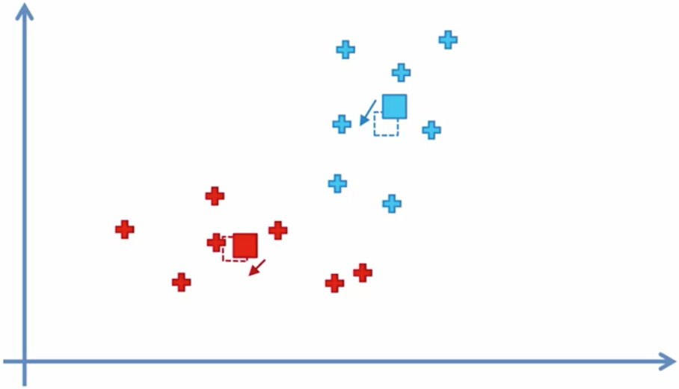
Step 4: Compute and place new centroid for each cluster

Slide 17
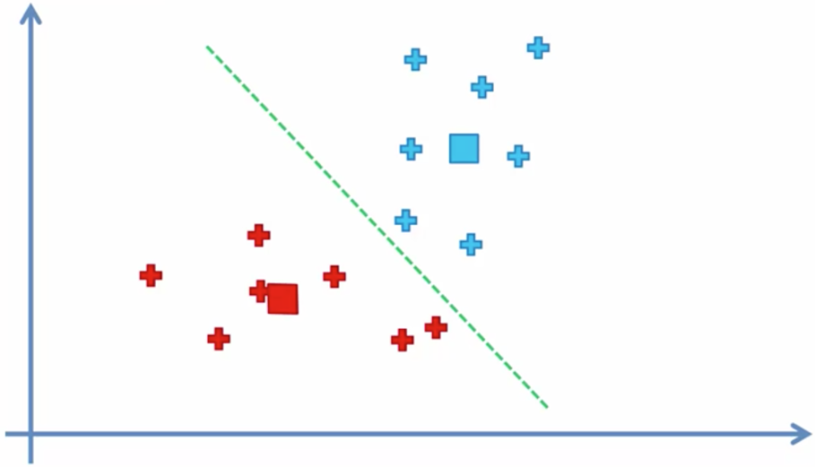
Step 5: Reassign each data point to the new closest centroid

Slide 18
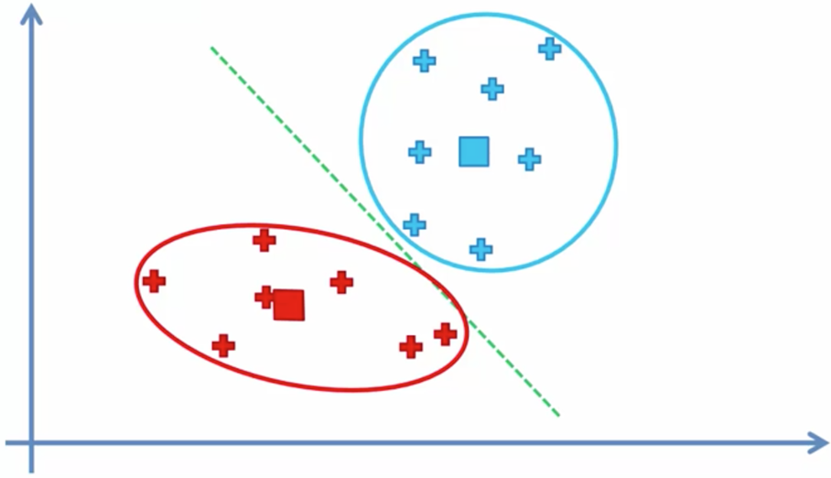
End

Slide 19
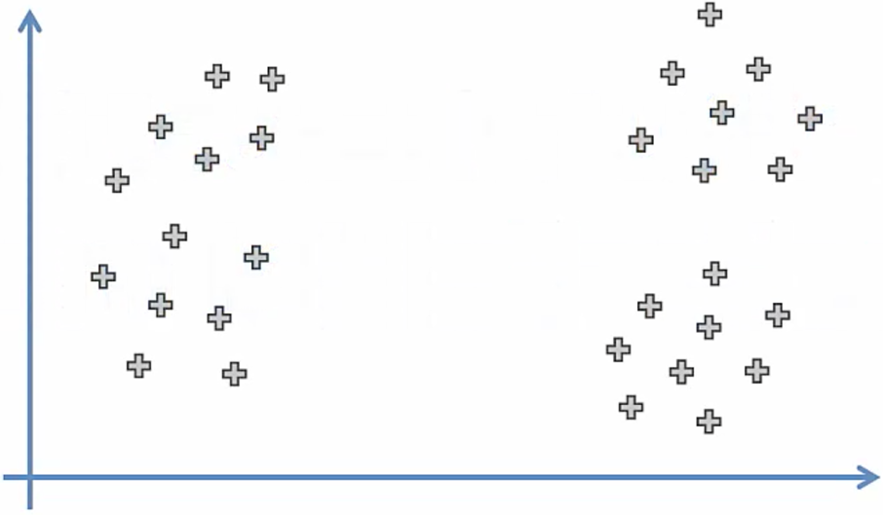
Random Initialization Trap
K=3

Slide 20
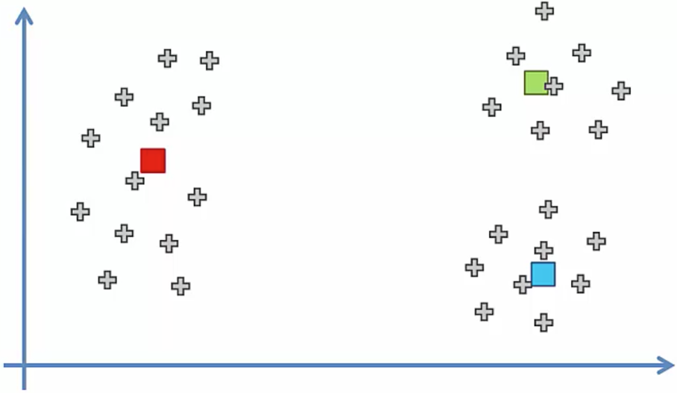
Random Initialization Trap
K=3

Slide 21
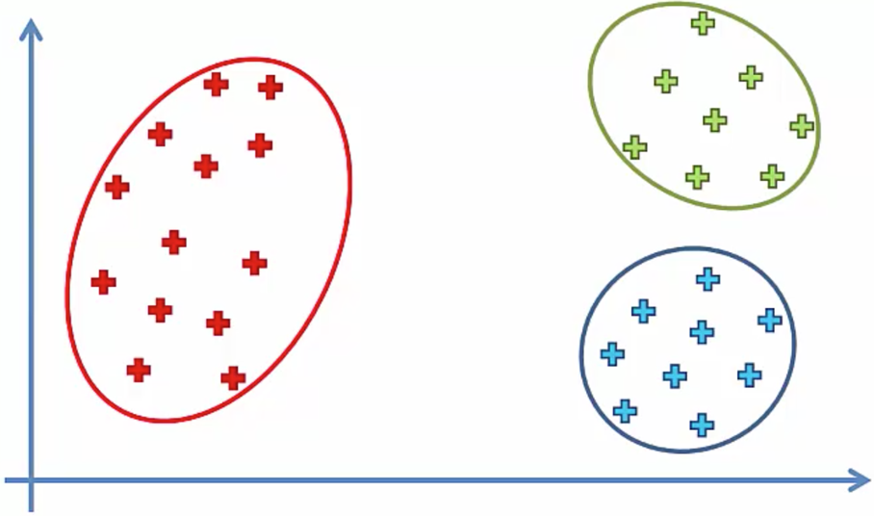
Random Initialization Trap
K=3

Slide 22
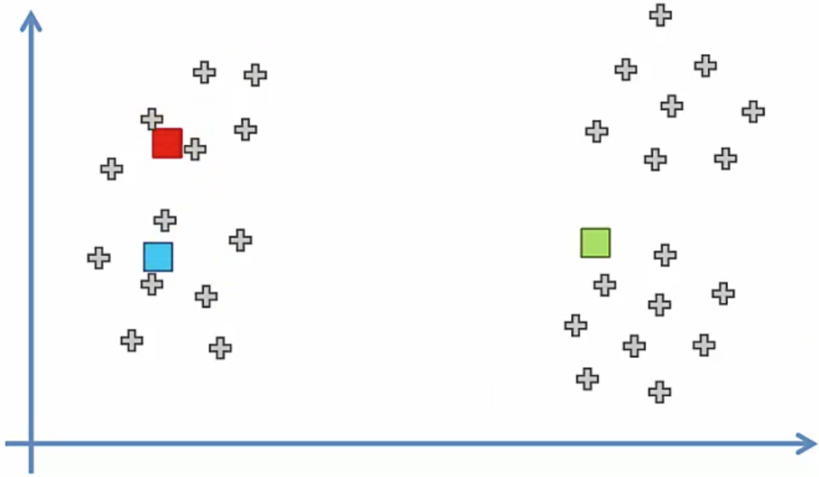
Random Initialization Trap
What if we select the initial centroids differently?

Slide 23
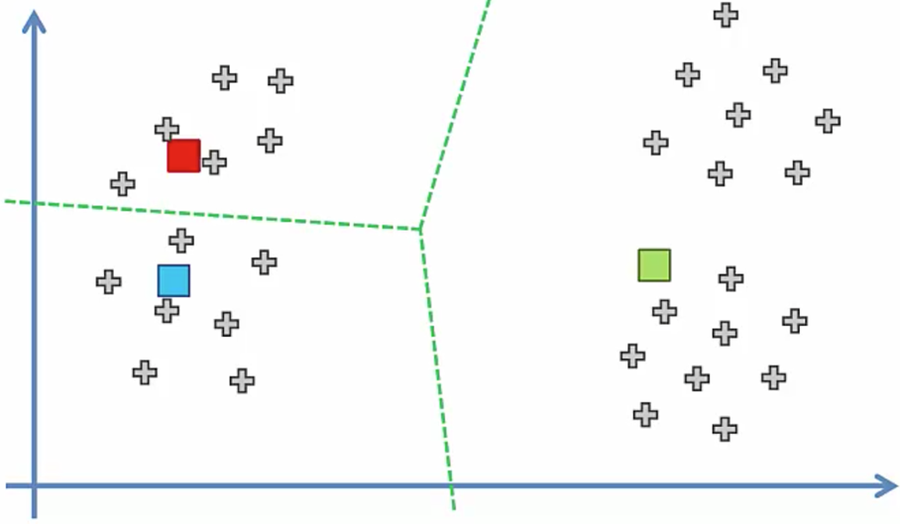
Random Initialization Trap
What if we select the initial centroids differently?

Slide 24
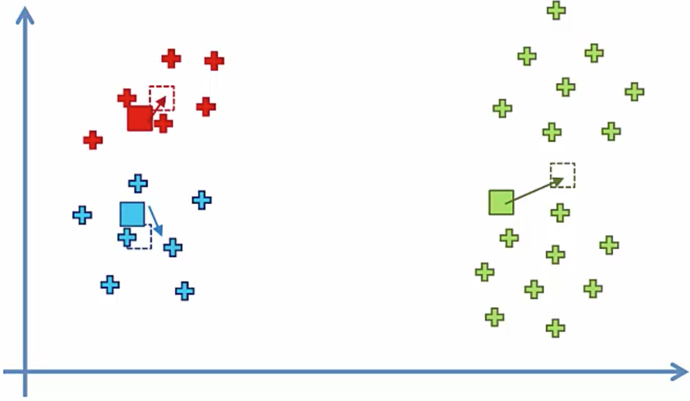
Random Initialization Trap
What if we select the initial centroids differently?

Slide 25
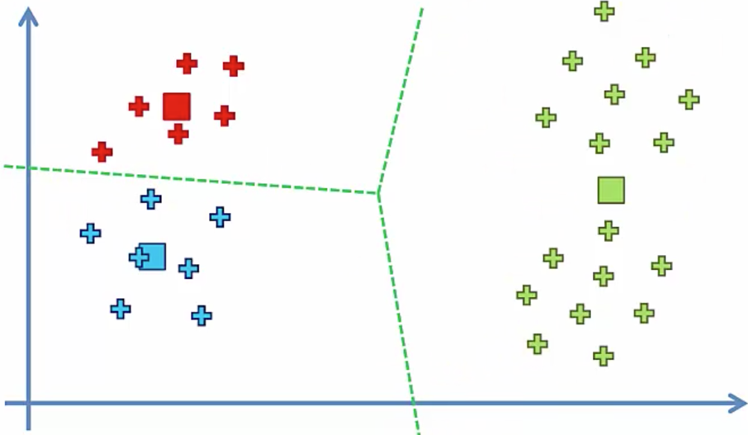
Random Initialization Trap
What if we select the initial centroids differently?

Slide 26
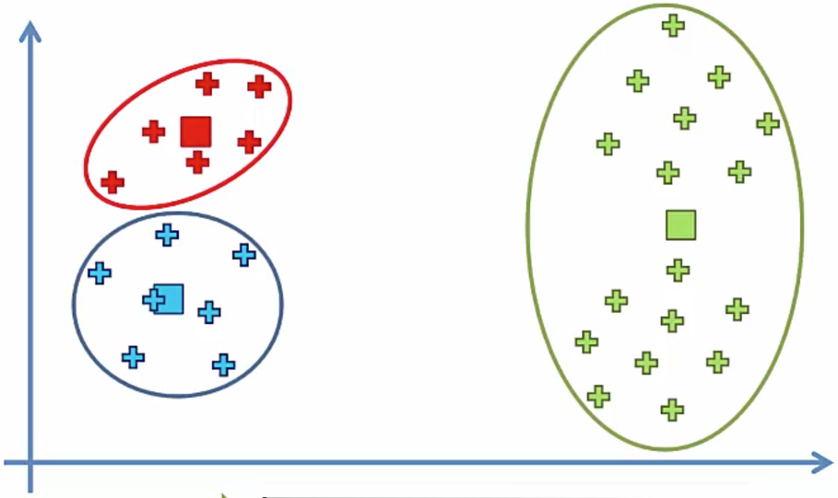
Random Initialization Trap
What if we select the initial centroids differently?

Slide 27
Random Initialization Trap
This should be the true result

Slide 28
Solution: K-Means++

Slide 29
Selecting the right number of clusters

Slide 30
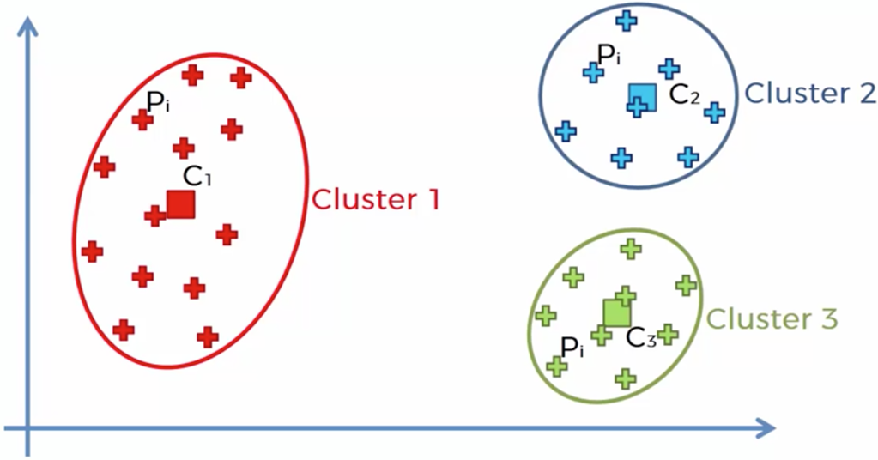
Selecting the right number of clusters

Slide 31
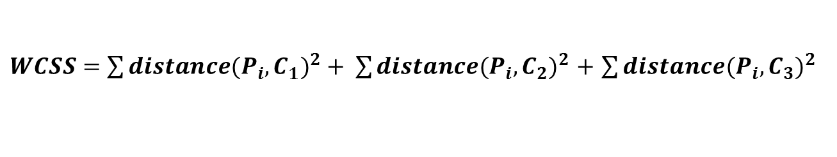
Within Cluster Sum of Squares
$WCSS=\sum{{distance(P_{i},C_{1})}^{2}}+ \sum{{distance(P_{i},C_{2})}^{2}}$ $+$ $\sum{{distance(P_{i},C_{3})}^{2}}$

Slide 32
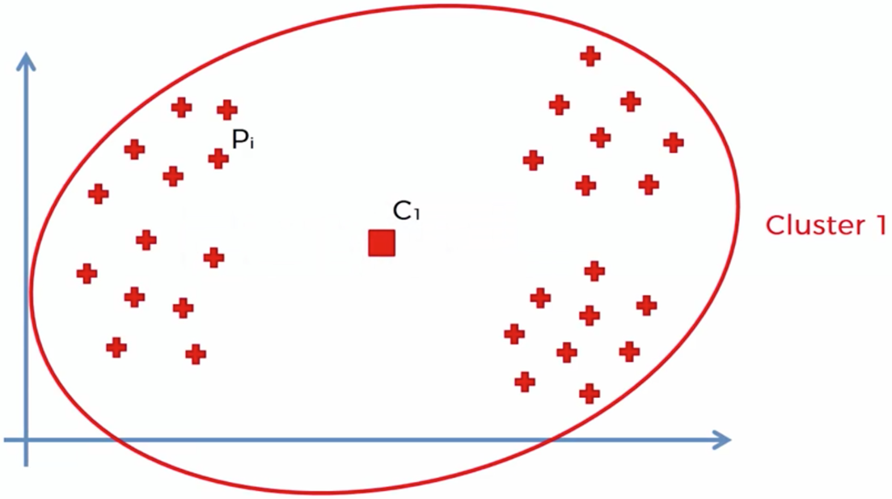
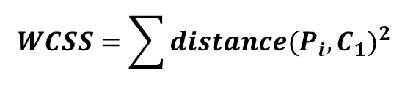
Within Cluster Sum of Squares
$$WCSS=\sum{{distance(P_{i},C_{1})}^{2}}$$

Slide 33
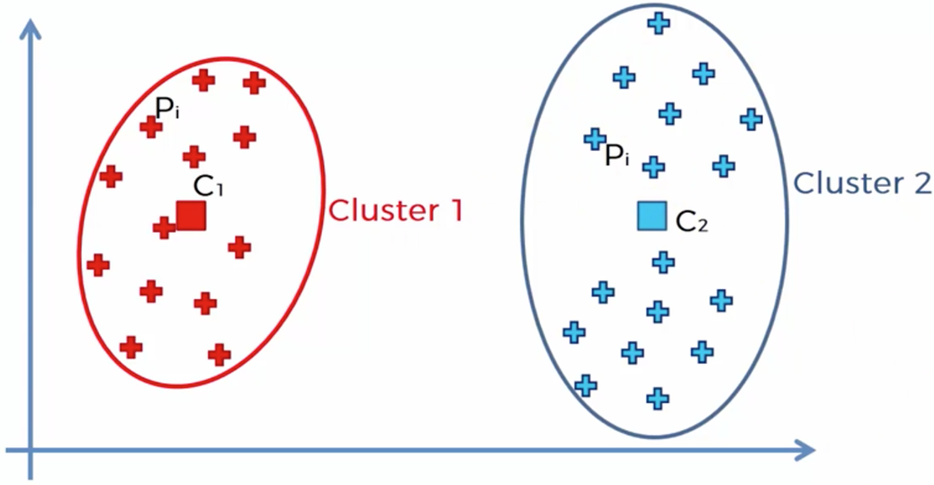
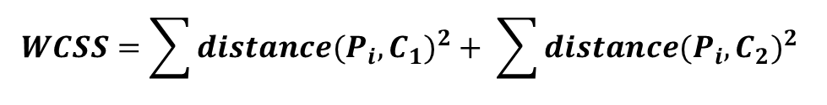
Within Cluster Sum of Squares
$$WCSS=\sum{{distance(P_{i},C_{1})}^{2}}+ \sum{{distance(P_{i},C_{2})}^{2}}$$

Slide 34
Within Cluster Sum of Squares
$WCSS=\sum{{distance(P_{i},C_{1})}^{2}}+ \sum{{distance(P_{i},C_{2})}^{2}}$ $+$ $\sum{{distance(P_{i},C_{3})}^{2}}$

Slide 35
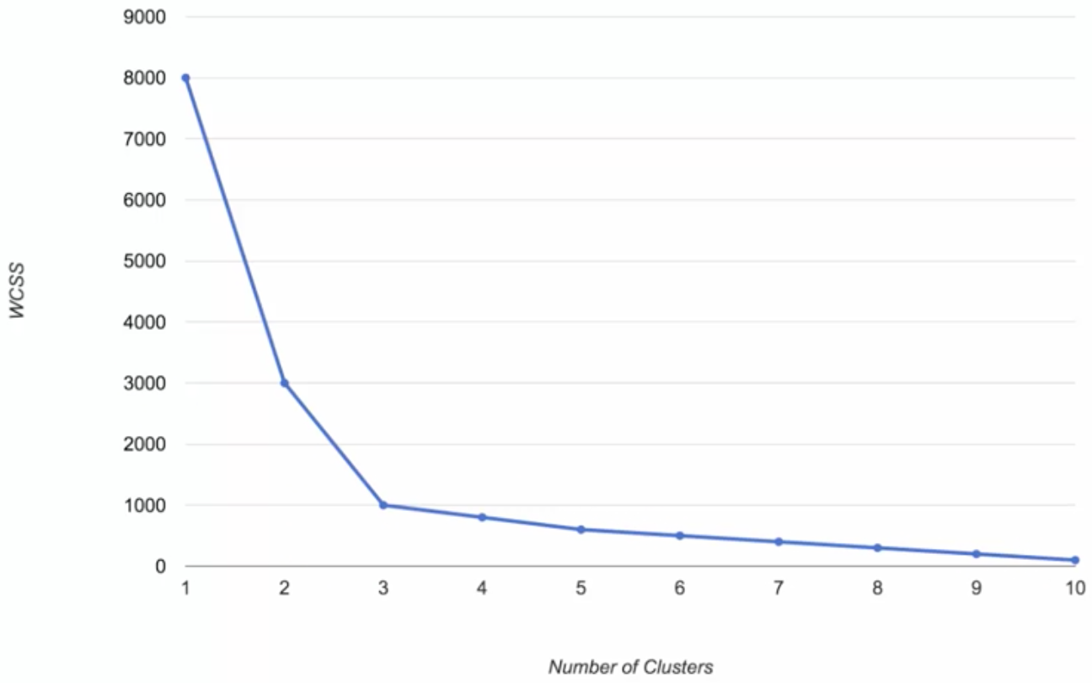
Selecting the right number of clusters (elbow method)

